Slide 1


SQL Server in Docker on Windows

Slide 2


Experience
Microsoft Certified Professional 2012/2014, 2016-2017
Over 10 years of experience
Multi-platform DBA
Community
Carlos Lopez
Guatemala SQL Server User Group – board member
Senior DBA, ATOS
/carlos-lopez-taks
Fields of Experience
@CarlosLopezDBA
MS SQL Server
Variaty of GNU / Linux Distros
Oracle 10-11g
carlosarturo.lopeztaks
caltls@gmail.com

Slide 3
Agenda
Inspect Docker on Windows
01
Have a look on Docker for windows and its Architecture.
Docker Features comparison
02
Compare between versions Docker 1 and 2, and its Features advantages and disadvantages.
Demo 1
03
Check out Docker running and interaction with CLI and features.: Kitematic, Powershell, ADS y VSC.
Demo 2
04
Control, administrate containers in SQL Server perspective.

Slide 4
Inspect Docker
Checking Docker on Windows 10 Environment.

Slide 5
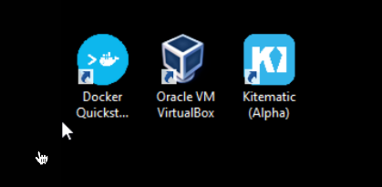
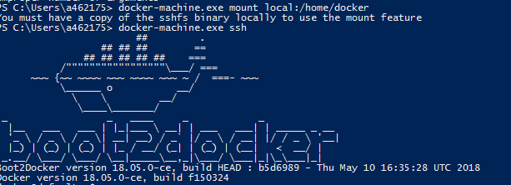
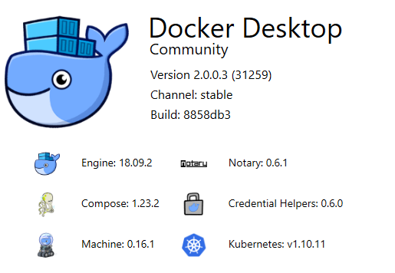
Benchmark
Docker Releases
Docker CE V1
WIN 7
 | V-Box | Default
 | Linux Kernel 3
 | Boot2Docker
 | .
 | Docker Tools
Docker CE V2
WIN 10
 | Hyper-V | Default
 | Linux Kernel 4
 | Mobylinux
 | Kubernetes
 | Docker Desktop

Slide 6

Timeline
Docker Releases
2016
2017
2018
2019
Docker CE 2.0.0.3
Kitematic 0.17.6, Kubernetes 1.10.11, Linux Kernel 4.9.93, Hyper-V
Docker CE 2.0.0.0
K8s Support, Docker Compose,
Docker CE 17.09.1
VPNKit Bridge, Fast Boot 2min
Docker for Windows 1.12.0
Docker Machine 0.8.0
Docker Compose 1.8.0.

Slide 7
Docker Tiers
Breakdown of tier service communication
CLI Client
CLI Client
Command Line Interface Powershell
Docker CLI
DockerCLI
Docker Interpreter interface for Command Line Interface through Powershell console
Docker Back End
Docker Back End
Set of resources to control the machine and container hub
Docker Core
DOCKER CORE
Layer that handles the service and the service container itself.

Slide 8
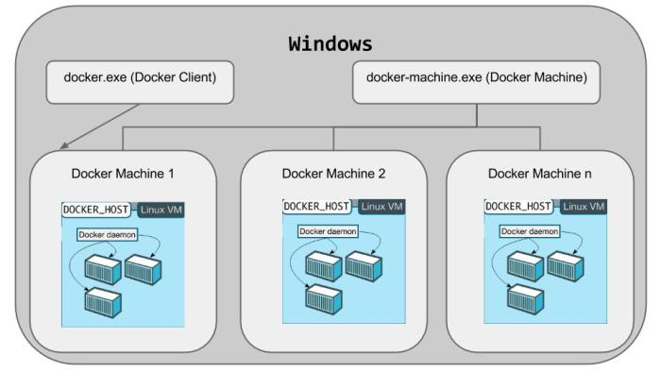
Basic Layout

Slide 9
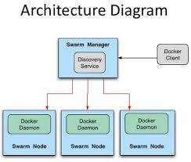

Slide 10
Demo 1
Checking Docker on Windows 10 Environment.

Slide 11
Demo 2
Administer Docker on Windows 10 Environment.

Slide 12
Thank you

